Slide 1
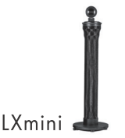

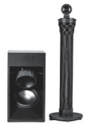

PowerBox 4180
or
PowerBox 4400pro

Slide 2
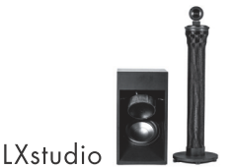
Woofer amplifier
Woofer amplifier
PowerBox 4180
or
PowerBox 4400pro

Slide 3
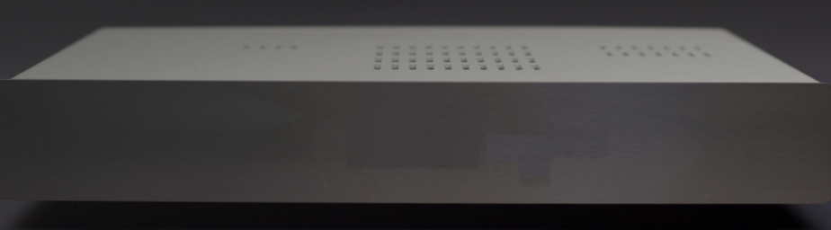
PowerBox 4180/4400pro
MASTER, drives
Mids & Highs
PowerBox 4400pro
FOLLOWER, drives
Woofers

Slide 4
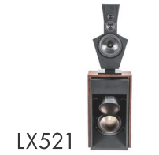

LX521.3
Woofer amplifier
Woofer amplifier
PowerBox 4180
or
PowerBox 4400pro

Slide 5
LX521.4
PowerBox 4180/4400pro
MASTER, drives
HiMids & Highs
PowerBox 4400pro
FOLLOWER, drives
LoMids & Woofers

Slide 6

LX521.4
setup with short
speaker cables
PowerBox 4400pro
MASTER, drives
all chassis left side
PowerBox 4400pro
MASTER, drives
all chassis right side

Slide 7
LX521 classic
setup with short
speaker cables
PowerBox 4400pro
analogue
drives
all chassis left side
PowerBox 4400pro
analogue
drives
all chassis right side

